Slide 1
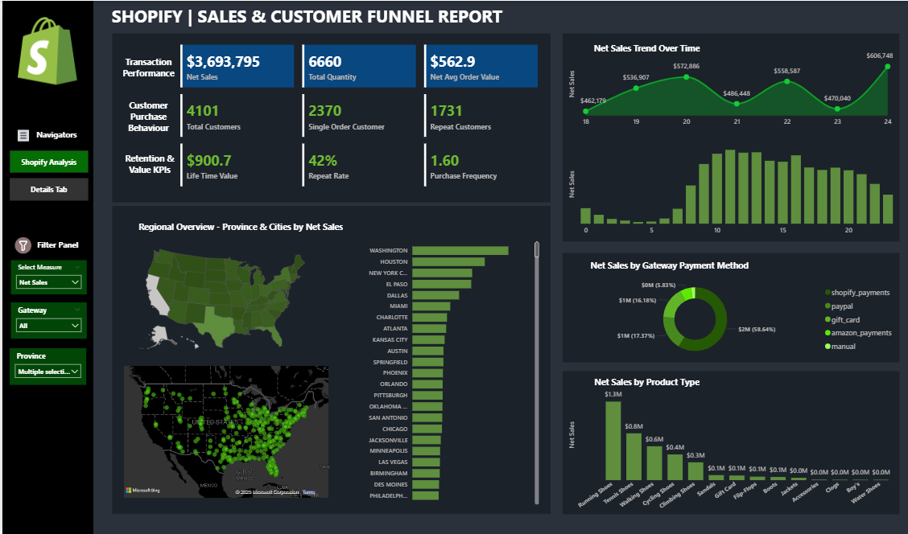

Slide 2
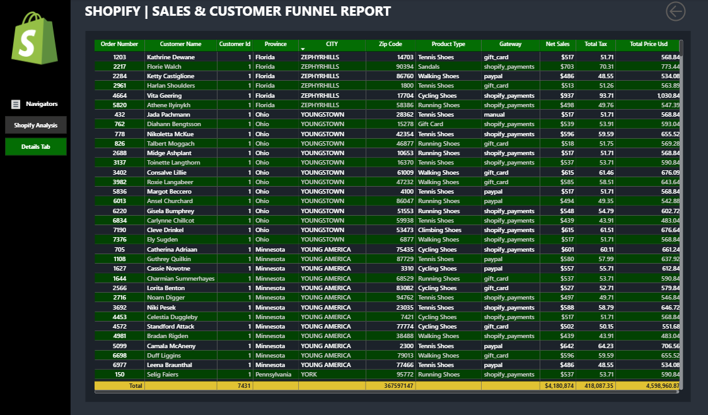

Slide 3


Shopify Analysis
STEPS IN PROJECT
Requirement Gathering/ Business Requirements
Data Walkthrough
Data Connection
Data Cleaning / Quality Check
Data Modeling
Data Processing
DAX Calculations
Dashboard Lay outing
Charts Development and Formatting
Dashboard / Report Development
Insights Generation

Slide 4
Shopify Analysis
BUSINESS REQUIREMENT
The goal of this project is to analyze Shopify sales data in Power BI to uncover meaningful insights into transaction performance, customer purchasing behavior, and long-term customer value. By designing an interactive dashboard, the objective is to help stakeholders identify patterns in revenue generation, customer retention, and engagement trends to support data-driven decision-making.
KPI’s Requirements
1. Transactions Performance
This section focuses on evaluating the overall health and effectiveness of sales operations by tracking:
Net Sales: Total revenue generated before tax.
Total Quantity: The cumulative number of products sold.
Net Avg Order Value: The average revenue per transaction, excluding tax.

Slide 5
Shopify Analysis
BUSINESS REQUIREMENT
KPI’s Requirements
2. Customer Purchase Behavior
Understanding how customers interact with the business is critical. This section highlights:
Total Customers: The count of unique buyers.
Single Order Customers: Customers who placed only one order.
Repeat Customers: Customers with more than one order, indicating loyalty.
3. Retention & Value KPIs
To evaluate long-term growth and customer value, this section includes:
Lifetime Value (LTV): The total revenue generated by a customer over time.
Repeat Rate: The percentage of customers who return to make another purchase.
Purchase Frequency: How often customers place orders, on average.

Slide 6
Shopify Analysis
BUSINESS REQUIREMENT
Charts Requirements
This section will support dynamic analysis using a measure selector for: Net Sales, Total Quantity, Total Customers, Repeat Customers
1. Regional Overview - Province and Cities
Filled Map (Province-Level)
Purpose: Display province-wise performance using color saturation based on the selected measure.
Interactivity: Changes dynamically with the measure selector.
Bubble Map / Density Map (City Level)
Purpose: Visually represent sales or customer density at a more granular level.
Bubble Size or Heat Intensity: Driven by the selected measure.
Tooltip: Shows all key metrics (Net Sales, Quantity, Total Customers, Repeat Customers).
Bar Chart (City-Level Performance)
Purpose: Compare top-performing cities based on the selected KPI.
Sorted: Descending order by selected measure.
Dynamic: Interacts with slicers/filters and responds to the KPI selector.

Slide 7
Shopify Analysis
BUSINESS REQUIREMENT
Charts Requirements
This section will support dynamic analysis using a measure selector for: Net Sales, Total Quantity, Total Customers, Repeat Customers
2. Sales Trend Over Time
Area Chart – Trend by Day
Purpose: Show the daily trend of the selected measure (e.g., daily Net Sales or daily Repeat Customers).
Interactivity: Changes dynamically based on the selected measure.
Bar Chart or Line Chart – Trend by Hour
Purpose: Display sales or customer activity by hour of the day (e.g., 0–23 hrs), revealing peak activity periods.
Use Case: Helps understand time-of-day behavior, useful for marketing or operational timing decisions.

Slide 8
Shopify Analysis
BUSINESS REQUIREMENT
Charts Requirements
This section will support dynamic analysis using a measure selector for: Net Sales, Total Quantity, Total Customers, Repeat Customers
3. Gateway Payment Method
Identify the most and least used payment methods.
Detect customer preferences across regions or campaigns.
4. Product Type
Determine which product types generate the highest revenue and order volume.
Understand how customer engagement varies across different product categories.

Slide 9
Shopify Analysis
BUSINESS REQUIREMENT
Charts Requirements
This section will support dynamic analysis using a measure selector for: Net Sales, Total Quantity, Total Customers, Repeat Customers
Provide a dedicated page to display transaction-level or detailed data.
Allow users to drill through from summary visuals (like charts and KPIs) to see underlying records.
Enable users to explore data at a granular level, such as individual orders, customers, or product types.
Help explain summary trends and validate aggregated metrics with raw data.

Slide 10
Shopify Analysis
Business Insights from Shopify Report
Strong Sales Performance Net Sales: $3.69M with 6,660 items sold. High Average Order Value: $563 → premium positioning.
Customer Behaviour 4,101 total customers. 2,370 (58%) are single-order customers → retention gap. 1,731 (42%) are repeat customers → solid loyalty base.
Retention & Value Repeat Rate: 42% shows strong engagement. LTV: $900.7 → each customer contributes high value. Purchase Frequency: 1.6 → room to drive more repeat purchases.

Slide 11
Shopify Analysis
Key Business Insights
Focus on converting single-order customers into repeat buyers.
Strengthen loyalty and retention programs to increase frequency beyond 1.6.
Leverage premium AOV to bundle products and upsell.
Invest in targeted campaigns to expand the repeat customer base and boost LTV further.

Slide 12
Shopify Analysis
Net Sales Insights
Trend Over Time Sales fluctuated between $462K – $606K. Peak observed at $606K, dip to $486K, showing cyclical demand patterns. Indicates potential seasonal impact or campaign-driven spikes.
Sales Distribution (Time of Day/Period) Stronger sales in mid-period (10–16 range) compared to early and late periods. Suggests concentration of customer activity at specific times → optimize marketing timing.
Payment Methods Shopify Payments dominate (59%), followed by PayPal (17%) and Gift Cards (16%). High reliance on one gateway → need for diversification risk management.

Slide 13
Shopify Analysis
Net Sales Insights
Product Type Performance Running Shoes ($1.3M) and Tennis Shoes ($0.8M) are top sellers. Other categories (Walking, Cycling, Climbing shoes) contribute smaller shares. Long-tail products (Sandals, Flip Flops, Boots, Accessories) have minimal revenue.
Regional Sales Strongest markets: Washington, Houston, New York, El Paso, Dallas, Miami. Dense clusters in South & East US, opportunities to scale in underpenetrated regions.

Slide 14
Shopify Analysis
Key Business Insights
Focus on repeat campaigns in peak sales periods to smooth dips.
Invest in geo-targeted marketing for top-performing cities while exploring growth in emerging ones.
Strengthen bundling/upselling around Running & Tennis shoes.
Monitor payment gateway dependency to reduce operational risk.
Optimize low-revenue categories (sandals, accessories) with better promotion or product repositioning.

Slide 15
Shopify Analysis
Total Quantity Insights
Trend Over Time Quantity fluctuates between 839 – 1,087 units. Peaks at 1,025 and 1,087 units, showing demand cycles similar to sales trend.
Regional Performance Top cities: Washington, Houston, New York, El Paso, Dallas, Miami. Distribution mirrors sales, confirming strong demand in key urban centers.
Payment Methods Shopify Payments (58%) dominate, followed by PayPal (17%) and Gift Cards (17%). Similar distribution to net sales → consistent payment preferences across customers.
Product Type Performance Running Shoes (2.4K units) lead significantly, followed by Walking Shoes (1.4K) and Tennis Shoes (1.0K). Niche products (sandals, flip flops, boots, accessories) show minimal volume → secondary focus.

Slide 16
Shopify Analysis
Key Business Insights
High demand concentration in Running & Walking shoes → optimize inventory and marketing for these categories.
Regional alignment between quantity and sales → double down on high-demand cities.
Low-volume products may need repositioning, bundling, or discontinuation.
Consistent payment mix suggests customer trust in Shopify Payments but reliance risk remains.

Slide 17
Shopify Analysis
Total Customer Insights
Trend Over Time Customer count fluctuated between 772 – 977. Growth peaks at 924 and 977, with dips showing periodic demand variation.
Regional Performance Top cities: Washington, Houston, New York, El Paso, Dallas, Miami. Strong presence across South & East US, concentrated in major urban hubs.
Payment Methods Shopify Payments (53%) lead, followed by PayPal (19%) and Gift Cards (19%). Consistent with sales/quantity trends → customers show stable checkout preferences.
Product Type Performance Running Shoes (1,917 customers) and Tennis Shoes (1,239) dominate. Walking (917) and Cycling (709) shoes also significant. Minimal customers for niche products (sandals, flip flops, boots, accessories).

Slide 18
Shopify Analysis
Key Business Insights
High concentration in footwear categories → Running & Tennis drive majority of customer base.
Top urban regions remain the strongest source of customers; regional campaigns can deepen penetration.
Payment trust is strong with Shopify → ensure smooth performance to avoid drop-offs.
Niche categories underperform → test bundling or targeted promotions to increase adoption.

Slide 19
Shopify Analysis
Repeat Customer Insights
Trend Over Time Repeat customers range 49 – 87, peaking at 87 and 84. Fluctuations show inconsistent retention, with clear dips after peaks.
Payment Methods Shopify Payments (80%) dominate repeat purchases. PayPal (9%) and Gift Cards (9%) are secondary.
Regional Distribution Strongest repeat customer bases: Washington, Las Vegas, Houston, Pittsburgh, Atlanta, Austin. Concentrated in urban centers with pockets of loyalty in multiple states.
Product Type Performance Running Shoes (355 customers) lead strongly, followed by Tennis Shoes (139) and Walking Shoes (64). Other categories (Cycling, Climbing, Sandals, Jackets) have minimal repeat traction.

Slide 20
Shopify Analysis
Key Business Insights
Retention is uneven → loyalty programs and personalized campaigns needed to stabilize repeat trends.
Running & Tennis Shoes drive most repeat business → expand upsell/cross-sell strategies around these categories.
High reliance on Shopify Payments → optimize checkout experience for loyalty customers.
Regional loyalty clusters (Washington, Las Vegas, Houston) → invest in location-specific offers and customer engagement.

Slide 21
Conclusion: Shopify Analysis
Retention is uneven → loyalty programs and personalized campaigns needed to stabilize repeat trends.
Running & Tennis Shoes drive most repeat business → expand upsell/cross-sell strategies around these categories.
High reliance on Shopify Payments → optimize checkout experience for loyalty customers.
Regional loyalty clusters (Washington, Las Vegas, Houston) → invest in location-specific offers and customer engagement.
The Shopify dashboard provides real-time visibility into sales, customer behaviour, and retention trends.
Insights highlight premium positioning (high AOV), strong repeat base, but a retention gap with single-order customers.
Running & Tennis shoes dominate performance, while niche categories remain underutilized.
Shopify Payments lead transactions, though reliance on one gateway poses operational risk.
Regional clusters (Washington, Houston, New York) offer growth opportunities through targeted campaigns.
Strategic focus on loyalty programs, upselling, and regional targeting can drive higher LTV and long-term growth.

